Slide 1
Our Schools, Our World
'The future of all life depends on our willingness to take action now’
David Attenborough
Brighton & Hove City Council
Katie Eberstein and Jonathan Cooper
Leicester City Council
Marc Tench, Jasmine Walker, Laura Barke

Slide 2
Our Schools, Our World Housekeeping
Fire exits
Toilets
Photographs
Tea/Coffee breaks provided

Slide 3
Our Schools, Our World Agenda
Time | Session
9:00 | Attendees arriving
9:20 | Introductions
9:45 | Climate Basics
10:30 | Break
10:45 | Leading for Sustainability – the research
12:15 | Lunch
13:00 | Leading for Sustainability – the framework
14:15 | Action Planning
15:15 | Next steps
15:30 | Finish

Slide 4
Our Schools, Our World Who’s Involved
Devon Brent Bedfordshire Leicester Brighton & Hove

Slide 5
Montrose School
Achieving, Caring, Aspiring
Our Schools
Queensmead
Primary Academy
Scraptoft Valley Primary School

Slide 6
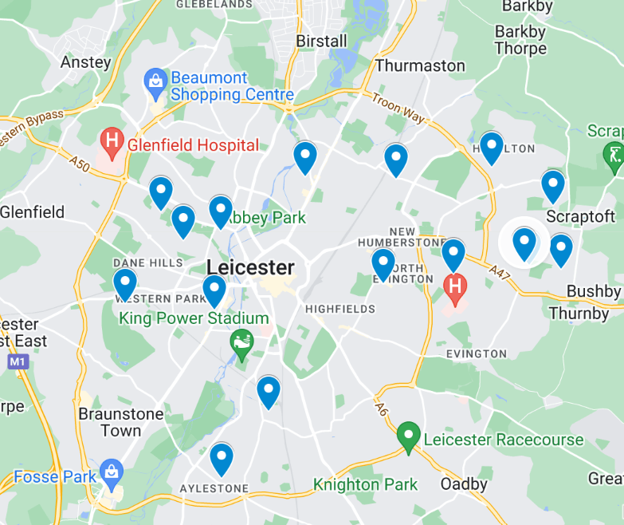
16
6700
800

Slide 7
Our Schools, Our World
Introductions
Talk to those around you:
Name, Role, School
Why are you here today?

Slide 8
Our Schools, Our World
The Climate Emergency in Leicester
Leicester City Council’s
Climate Ready Leicester Plan
A plan for warm homes, lower bills, solar energy, new skills and jobs, clean air and a greener, resilient city

Slide 9
Climate Ready Leicester aims
1. A net zero city
2. Reduced emissions outside the city
3. An adapted and resilient city
4. A people-centred transition
5. A net zero and climate-adapted council
Leicester City Council declared a Climate Emergency in 2019

Slide 10
The action plan
96 actions across seven themes
Refreshed annually
Includes
Net Zero Delivery Plan for our own estate and operations
Further housing retrofit and low carbon new-build
Low carbon workspaces at Dock 3-5, Pilot House, Pioneer Park
Green skills bootcamps
Continued work across active travel, buses and EV infrastructure
Further flood schemes and engagement with communities at risk
Aligning new Waste Strategy with climate aims
Climate Ready Leicester comms campaign including action guide for residents and more

Slide 11
Our Schools, Our World Training Overview
Day One
Leading for Sustainability
City Hall
Attending: Heads, governor, SPL
------------------------------------------------------
9.15am – 3.30pm
Climate/Nature Basics
BREAK
Leading for Sustainability – Research
LUNCH
The OSOW Framework
Action Planning
Day Two
Curriculum Development
Queensmead Primary Academy
Attending: SPL
------------------------------------------------------
9.15am – 3.30pm
Curriculum Development
BREAK
Curriculum Assessment
LUNCH
Nature Connection & Outdoor Learning
How to Talk About Climate Change
(ThoughtBox)
Day Three
Climate Action Planning
City Hall
Attending: SBM, Site Manager, (SPL from 11am)
------------------------------------------------------
9.15am – 3.30pm
Climate/Nature Basics
BREAK
Climate Action Planning - background
LUNCH
Measuring Carbon
Climate Action Planning - practical

Slide 12
Our Schools, Our World Aims of OSOW – Nationally Pioneering Work
Develop an integrated environmental education curriculum gradually and systematically ‘greening’ the curriculum and supporting the development of green skills
Enable children and young people to develop a close connection with nature
Create school organisational systems and practices which support sustainability and the school and regional Carbon Neutral 2030 targets
Empower children and young people and their families to become changemakers both personally and collectively and inspire a strong sense of hope for the future

Slide 13
Our Schools Our World Climate Basics
Lots of different levels of experience and knowledge within this room
With those around you - Discuss the climate knowledge of your whole staff and pupils

Slide 14
Embedded video removed for size – find here: Earth to COP | #COP26 | Climate Action - YouTube

Slide 15
Our Schools, Our World
Climate Change Basics
CAUSE
CONSEQUENCE
Human Activity
Greenhouse Gases
Greenhouse Effect
Climate Consequences
Impact on the Planet
Impact on Humans
Impact on Biodiversity
SOLUTIONS ?

Slide 16
CAUSE
CONSEQUENCE
Human Activity
Greenhouse Gases
Greenhouse Effect
Climate Consequences
Impact on the Planet
Impact on Humans
Impact on Biodiversity
SOLUTIONS ?

Slide 17
Our Schools, Our World
What does climate change mean for you personally?
What does climate change mean for you professionally?
What does climate change mean for your school?

Slide 18
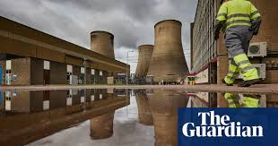
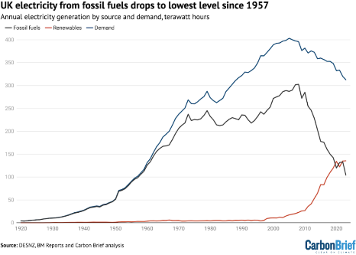
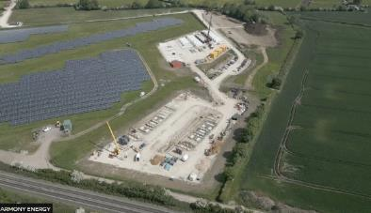
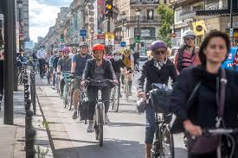
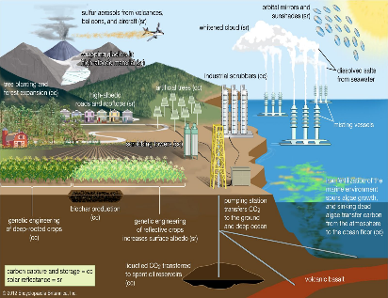
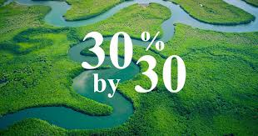
Reasons for optimism
Our Schools Our World Reasons for Optimism – nationally & globally

Slide 19
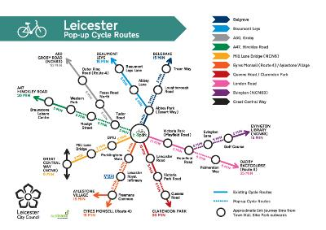
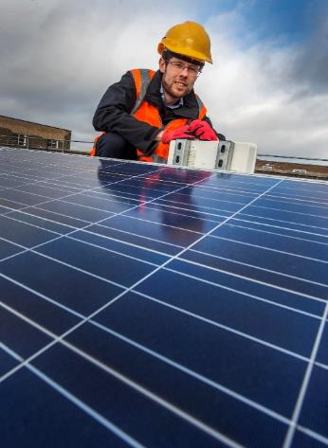
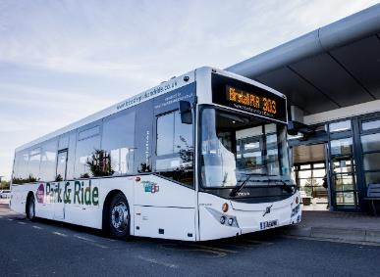
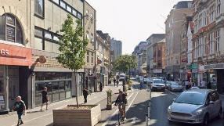
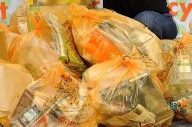
Reasons for optimism
Our Schools Our World Reasons for Optimism - locally
Well-connected cycle routes across the city and beyond
Electrification of bus network
634 kWp PV systems on council buildings generating 524,954 kWh/y
A total of 63.72 % of waste was diverted from landfill (2022-23)
Further pedestrianisation across the city

Slide 20
Reasons for optimism
Our Schools Our World Reasons for Optimism - schools
Sharing positive news stories from our schools

Slide 21
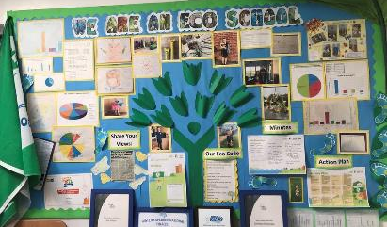
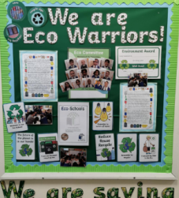
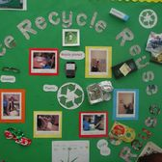
LEADERSHIP FOR SUSTAINABILITY – excellence in practice based on a meta-analysis of research Including: Dr David Dixon - Leadership for Sustainability 2022/Marouli, C. (2021). Sustainability education for the future? Challenges and implications for education and pedagogy in the 21st century/Mogaji, I. M., & Newton, P. (2020). School leadership for sustainable development: A scoping review. Journal of Sustainable Development/Awodiji (2023) School leadership development for sustainability in the post-digital era

Slide 22
Our Schools, Our World Current NC provision

Slide 23
Our Schools, Our World Our responsibility
50% of young people are unsure of how they can personally help

Slide 24
DfE requirements
By 2025:​
All education settings will have nominated a sustainability lead
​
All education settings will have put in place a climate action plan
decarbonisation
adaptation and resilience
biodiversity
climate education and green careers

Slide 25
Our Schools, Our World Defining Sustainability
avoid the depletion of natural resources
keep an ecological balance
not allow the quality of life of modern societies and future generations to decrease

Slide 26
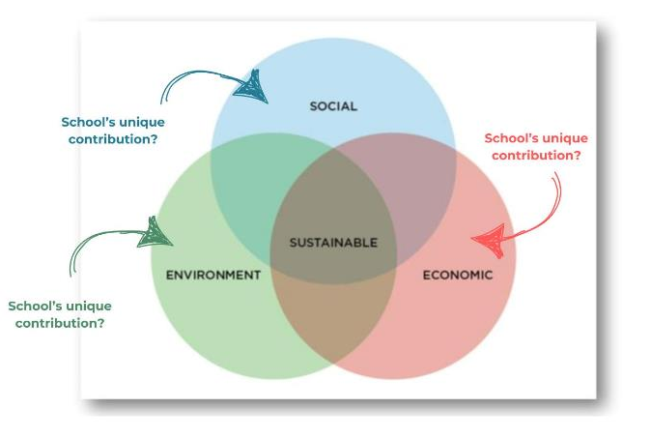
Our Schools, Our World Leading For Sustainability
Defining sustainability…
avoid the depletion of natural resources
keep an ecological balance
not allow the quality of life of modern societies and future generations to decrease

Slide 27
Our Schools, Our World Our Present Relationship with the Planet

Slide 28
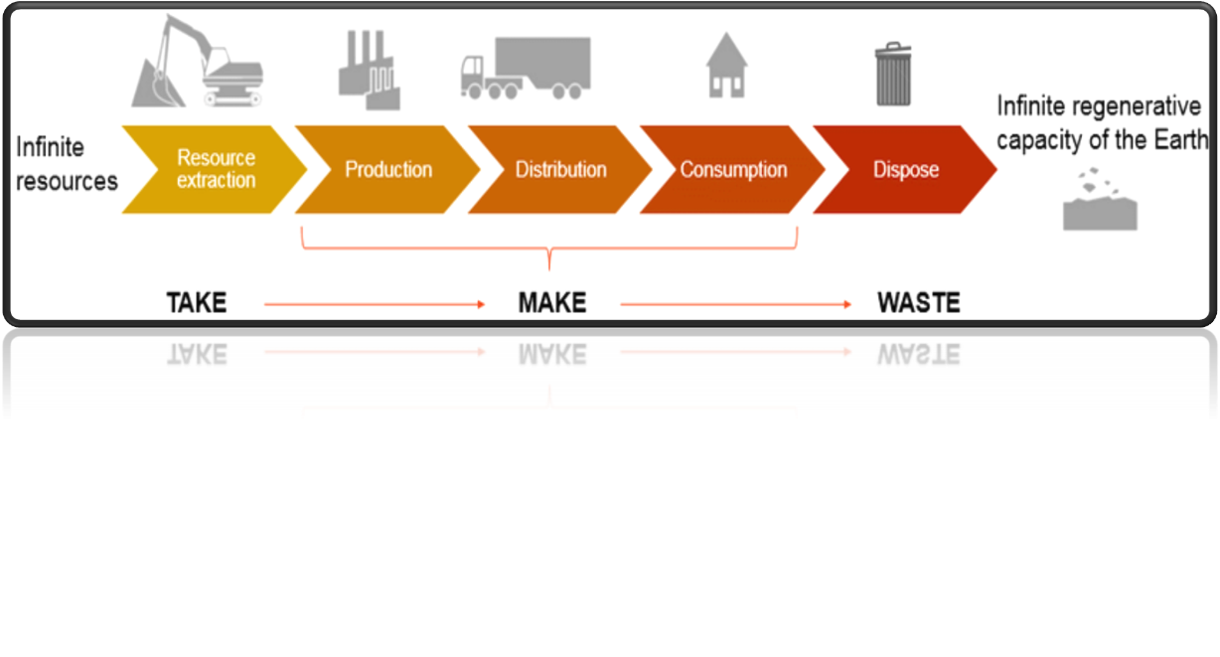
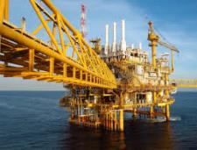
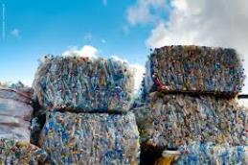
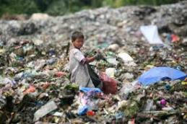
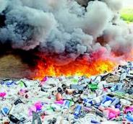
Our Schools Our World Linear Economy

Slide 29
Our Schools, Our World Ecological Footprint

Slide 30
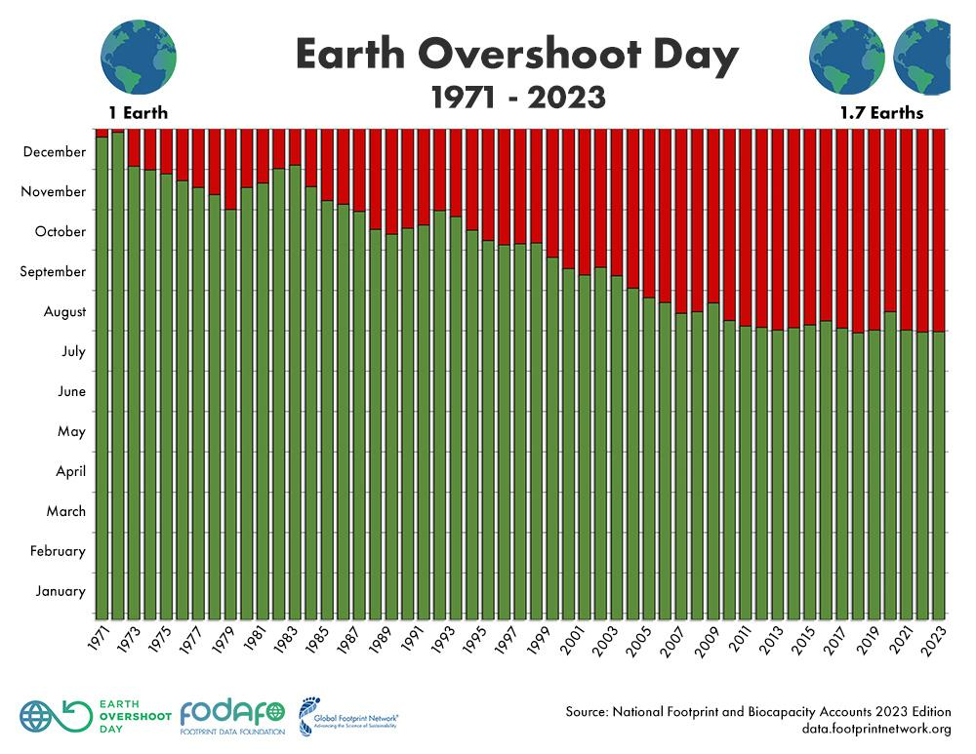
Our Schools, Our World

Slide 31
Our Schools, Our World

Slide 32
Our Schools, Our World
‘We have not borrowed our children’s future,
we have stolen it and we are still stealing it’
Jane Goodall, Naturalist

Slide 33
Our Schools, Our World Circular Economy

Slide 34
Our Schools, Our World Social, Economic and Environmental Impact (Local and Global)
School car parks
School lunch burger and chips day
Purchasing new reading books for classrooms
Laying astroturf

Slide 35
Our Schools, Our World Change Our Approach
1.REFUSE
2.REDUCE
3.REUSE
4.REPAIR
5.REPURPOSE
6.RECYCLE
7.RECOVER

Slide 36
LEADERSHIP FOR SUSTAINABILITY – excellence in practice based on a meta-analysis of research Including: Dr David Dixon - Leadership for Sustainability 2022/Marouli, C. (2021). Sustainability education for the future? Challenges and implications for education and pedagogy in the 21st century/Mogaji, I. M., & Newton, P. (2020). School leadership for sustainable development: A scoping review. Journal of Sustainable Development/Awodiji (2023) School leadership development for sustainability in the post-digital era

Slide 37
The process
School Community
Leadership commitment
Working group
Nature Connection
Whole School
Climate Science Vision
Assemblies
Changemakers
Families
Staff
Council/MAT
Local experts and organisations
Launch
Zero Carbon Audits
Training
Curriculum Review
Student + stakeholder voice established

Slide 38
The process
School Community
Leadership Commitment
Working group
Research Findings
School sustainability strategies are most effective when schools are:
'driven by moral purpose'
authentic and creative
Changemakers
Whole School
Training
Audit
and
Action
Council/MAT
Local experts and organisations
Nature Connection
Vision and Culture
Launch
Curriculum and Assemblies
Student + stakeholder voice

Slide 39
Roles and responsibilities
Our Schools, Our World Roles and Responsibilities
Headteacher | Senior Programme Lead | Lead Governor
Leading the vision and strategy Establishing termly working group for whole school action Facilitating curriculum development opportunities and CPD opportunities Ensuring completion and monitoring of OSOW Framework and Climate Action Plan | Supporting vision and strategy Leading on curriculum development strategy (linking to whole school action) Undergoing training in: Climate Change/Carbon Literacy Supporting eco-anxiety Climate Change curriculum structures Training other staff Linking with schools/organisations/initiatives On-going liaison/joint work with hub leader and climate adviser | Key member of the strategy group Ensures OSOW/sustainability is key FGB item and on committee agendas Monitoring and evaluation: Communication of and engagement with OSOW programme Vision and OSOW planning Impact of OSOW plan Implementation + impact of Climate Action Plan Curriculum improvement and impact

Slide 40
The process
School Community
Research Findings
School sustainability strategies are most effective when schools are committed to:
staff development
induction
succession planning
Working group
Changemakers
Whole School
Training
Audit
and
Action
Council/MAT
Local experts and organisations
Nature Connection
Vision and Culture
Launch
Curriculum and Assemblies
Student + stakeholder voice

Slide 41
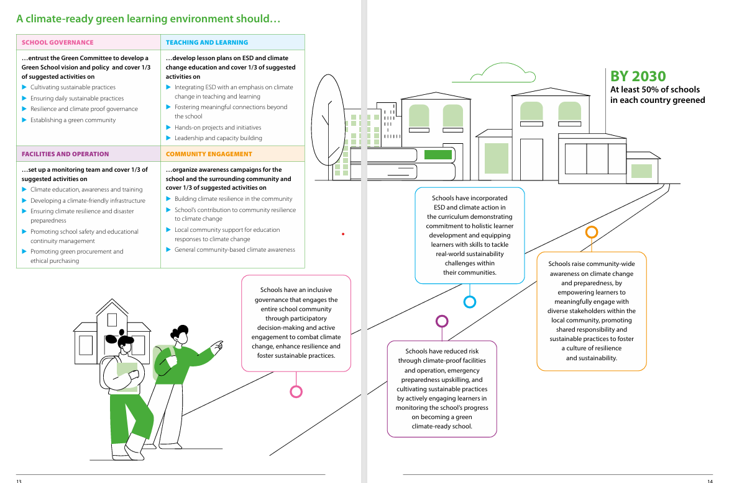
Is this needed? could it just be mentioned?

Slide 42
Our Schools, Our World
CPD framework/schedule
Year 1
Climate science (All staff), establishing vision – INSET day?
Supporting eco-anxiety – 1 X staff meeting
Mapping conceptual milestones – 2 X staff meetings over two terms
Greening the present curriculum – 1 staff meeting for three terms
Creating an assembly programme – Plan assemblies through networking and using resources on website
Year 2
Reviewing success of initial curriculum based on assessment – 1 staff meeting
Outdoor learning practice and planning - 2 staff meetings

Slide 43
Our Schools, Our World
CPD framework/schedule
Suggested Time | Training | When | To whom | Resources
Year 1 term 1 | Climate Basics | INSET | All school staff | ‘Great Big Lesson for Climate & Nature’ - video in training section of website
Year 1 term 1 or 2 | How to talk to young people about climate change | INSET / staff meeting | Teaching staff and TAs | ThoughtBox video in training section of website
Year 1 term 2 or 3 | Curriculum Development ‘Conceptual milestones’ X2 | Staff meeting | Teaching staff | Conceptual Milestones document
Year 1 term 2 or 3 | Curriculum Development ‘Greening the Curriculum’ 1 | Staff meeting | Teaching staff | Greening the curriculum documents
Subsequent term | ‘Greening the Curriculum’ 2 | Staff meeting | Teaching staff | Greening the curriculum documents
Subsequent term | ‘Greening the Curriculum’ 3 | Staff meeting | Teaching staff | Greening the curriculum documents
Year 2 | Reviewing success of initial curriculum | Staff meeting | Teaching staff | Use of assessment resources
Year 2 | Outdoor Learning Practical techniques and planning | Staff meeting | Teaching staff | Outdoor learning resources on OSOW website

Slide 44
The process
School Community
Research Findings
School sustainability strategies are most effective when schools:
develop a strong culture and shared vision for a better world
Working group
Changemakers
Whole School
Training
Audit
and
Action
Council/MAT
Local experts and organisations
Nature Connection
Vision and Culture
Launch
Curriculum and Assemblies
Student + stakeholder voice

Slide 45
Our Schools, Our World School Values and Learning Attitudes

Slide 46
Our Schools, Our World Bringing People With You - Culture
Passion and commitment
Training and knowledge
Shared vision
Clear communication of vision and plans
Pupil voice central
Clear roles and expectations – personal and professional
PM structures
Collective impact
Organic developments as well as planned improvements
Regular celebration of impact

Slide 47
The process
School Community
Research Findings
School sustainability strategies are most effective when schools:
challenge and focus on solutions
Working group
Changemakers
Whole School
Training
Audit
and
Action
Council/MAT
Local experts and organisations
Nature Connection
Vision and Culture
Launch
Curriculum and Assemblies
Student + stakeholder voice

Slide 48
Our Schools, Our World Our Mantra!
Is it green?
Could it be greener?

Slide 49
Our Schools, Our World School Values and Learning Attitudes

Slide 50
The process
School Community
Working group
Research Findings
School sustainability strategies are most effective when :
stakeholder voice is enabled and empowered
Changemakers
Whole School
Training
Audit
and
Action
Council/MAT
Local experts and organisations
Nature Connection
Vision and Culture
Launch
Curriculum and Assemblies
Student + stakeholder voice

Slide 51
Our Schools, Our World Pupil Voice
Understanding the issues
Surveys
Identifying priorities and solutions
Representation on groups
Class/school/family action
Curriculum development
Family influencer
Assemblies

Slide 52
Our Schools, Our World Engaging Families
Launch
Regularly sharing plans/targets
Sharing curriculum aims
Skills audit/engagement
Regular joint activities/pledges
Speakers
Representation on key groups
PTA
Events
Tours of school
Website/twitter

Slide 53
The process
School Community
Working group
Research Findings
School sustainability strategies are most effective when schools:
integrate rather than layer
Changemakers
Whole School
Training
Audit
and
Action
Council/MAT
Local experts and organisations
Nature Connection
Vision and Culture
Launch
Curriculum and Assemblies
Student + stakeholder voice

Slide 54
Our Schools, Our World School Values and Learning Attitudes

Slide 55
Our Schools, Our World Curriculum Development - Zones
Interwoven in lessons
Action and empowerment
Connections with nature
Culture
School organisation – sustainable practices
Link to the UN SDGs
Assemblies
Connecting locally, nationally and internationally
Family and local community
Special projects
Staff commitment through pledges
School values and learning attitudes
Climate Change Curriculum zones of provision and influence
Pupil voice
Staff / community voice
Notes:
Try to get text bigger – Beth

Slide 56
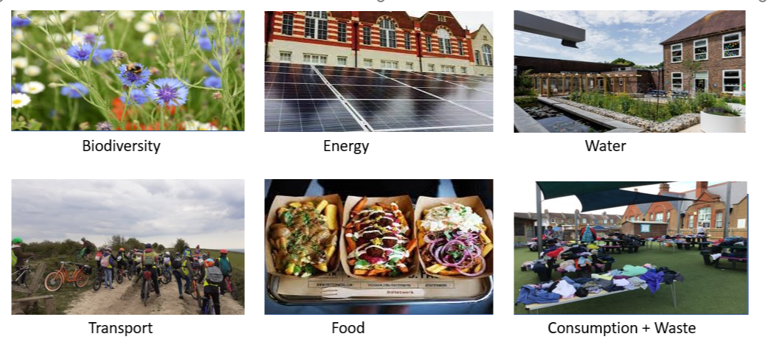
Our Schools, Our World Overarching Themes

Slide 57
Our Schools, Our World Conceptual Milestones
Our Schools, Our World Conceptual Milestones
End of Year 2
Key Concepts | Year Group/Term/Subject/Assembly
Local/national/global
Weather
Climate
Environment
Global warming
Monoculture
Biodiversity
Extinction
Rewilding
Wood wide web
Conservation
Energy
Waste
Consumption
Pollution
By end of Year 4
Key Concepts | Year Group/Term/Subject/Assembly
Climate change
Atmosphere
Greenhouse effect
Greenhouse gas emissions
Carbon
Carbon emissions

Slide 58
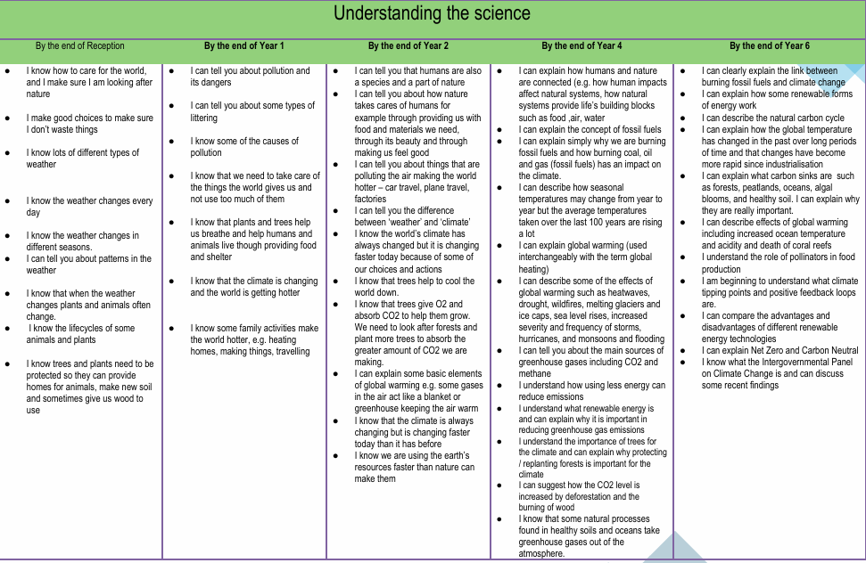
Our Schools, Our World Progression in Skills and Knowledge

Slide 59
Our Schools, Our World Additional Resources
Biodiversity
Autumn 24
Assembly Concepts | Diversity
Assembly Knowledge | Celebration of our natural world - What is biodiversity and why is it important? Ecosystems and trophic cascade Our local ecosystem - Our Living Coast 30 days wild in June Human impact on biodiversity The school environment UN Sustainable Development Goals 14 and 15 – Protect life on land and in water
Key concepts | What is biodiversity and what is its value? Ecosystems Life in our biosphere - living coast Impact of actions on biodiversity and ability of planet to adjust
Class/School action | https://www.rspb.org.uk/globalassets/downloads/documents/positions/education/top-tips-for-schools-to-engage-with-biodiversity.pdf On-going help with biodiversity areas – development of specific infant playground area Development of use of pond and forest garden – more planting School growing projects – plant trees Composting 30 days Wild June
Family Commitment/ Pledge | How can we encourage biodiversity at home – flats/houses –guides provided Challenge – learn the names of the trees in our neighbourhood Community celebration – Me and my plants. Photos + names of plants we love at home or on the way to school What can you find in a metre squared of grass? Competition – types of plants/insects 30 days wild

Slide 60
Our Schools, Our World Overarching Themes

Slide 61
Our Schools, Our World Sustainable Development Goals

Slide 62
The process
School Community
Working group
Research Findings
School sustainability strategies are most effective when schools:
fully recognise the benefits of nature connection
Whole School
Changemakers
Training
Nature Connection
Council/MAT
Local experts and organisations
Vision and Culture
Audits and Action
Launch
Curriculum and Assemblies
Student + stakeholder voice

Slide 63
Our Schools, Our World Research Into The Impact of Environmental
and Sustainability Education
Greater well-being
Increased social engagement and positive environmental behaviours
Higher levels of concentration and resilience
Enhancing critical thinking skills and problem solving skills
Effective teamwork skills
Personal growth and life skills including confidence, autonomy, and leadership
More effective acquisition of STEM skills due to purposeful/meaningful context
Development of Green Career skills

Slide 64
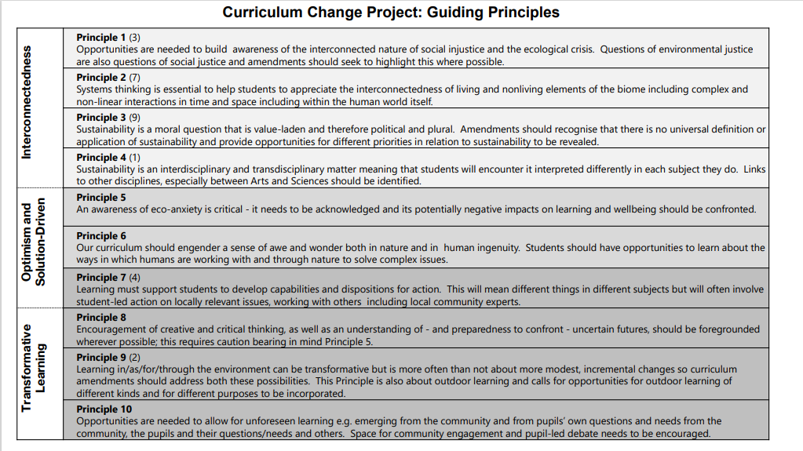
Our Schools, Our World Teach the Future – Guiding Principles

Slide 65
The process
School Community
Working group
Research Findings
School sustainability strategies are most effective when schools:
think systematically and as 'systems thinkers'
Whole School
Changemakers
Training
Audit
and
Action
Council/MAT
Local experts and organisations
Vision and Culture
Nature Connection
Launch
Curriculum and Assemblies
Student + stakeholder voice

Slide 66
Our Schools, Our World A Systematic Approach to School Operational Action Areas
Environmental education
Travel and transport
Biodiversity
Water management
Captaincy
Curriculum
Campus action
Community Culture
Procurement and third parties
Waste management
Food and catering
Building and construction
Energy and carbon management
Community engagement

Slide 67
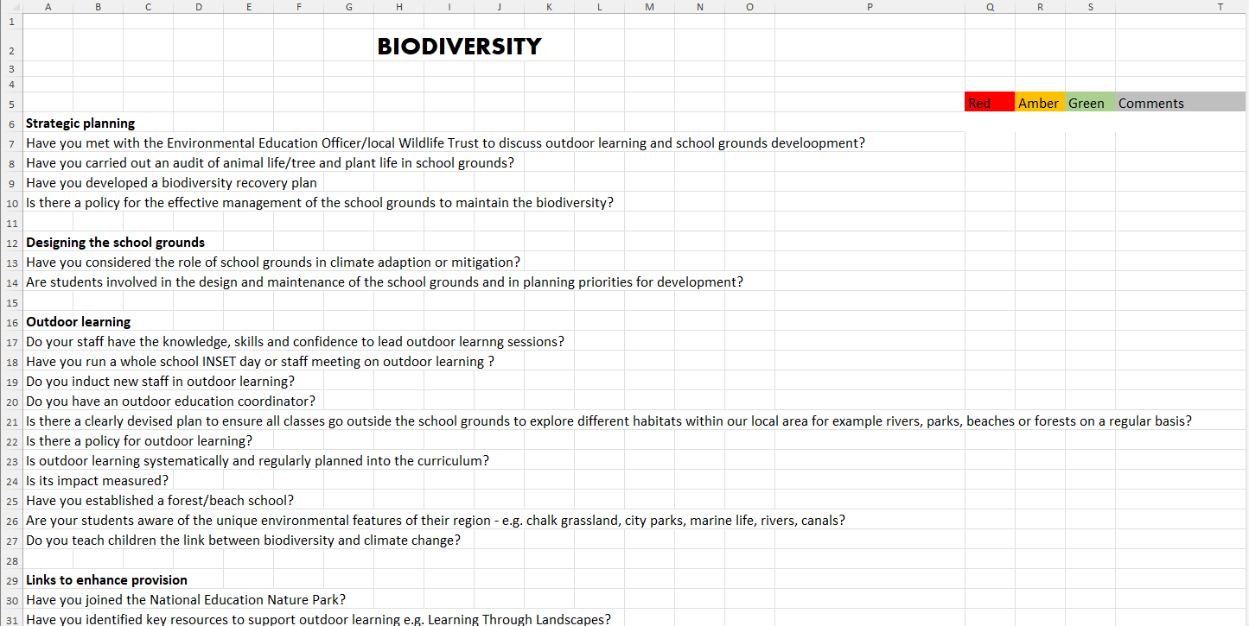
Our Schools, Our World Audits

Slide 68
Our Schools, Our World Our Mantra!
What’s the impact of:
eating one less burger a week?
buying one less t-shirt?

Slide 69
Our Schools, Our World Systems Thinking Organisation
Continual awareness of:
our impact globally as well as locally of all our decisions: social, economic and environmental
a circular economy approach
an understanding that healthy systems generate healthy decisions and healthy actions

Slide 71
The process
School Community
Working group
Research Findings
School sustainability strategies are most effective when schools are:
reveals the power of collectivism
Changemakers
Whole School
Training
Audit
and
Action
Council/MAT
Local experts and organisations
Nature Connection
Vision and Culture
Launch
Curriculum and Assemblies
Student + stakeholder voice

Slide 72
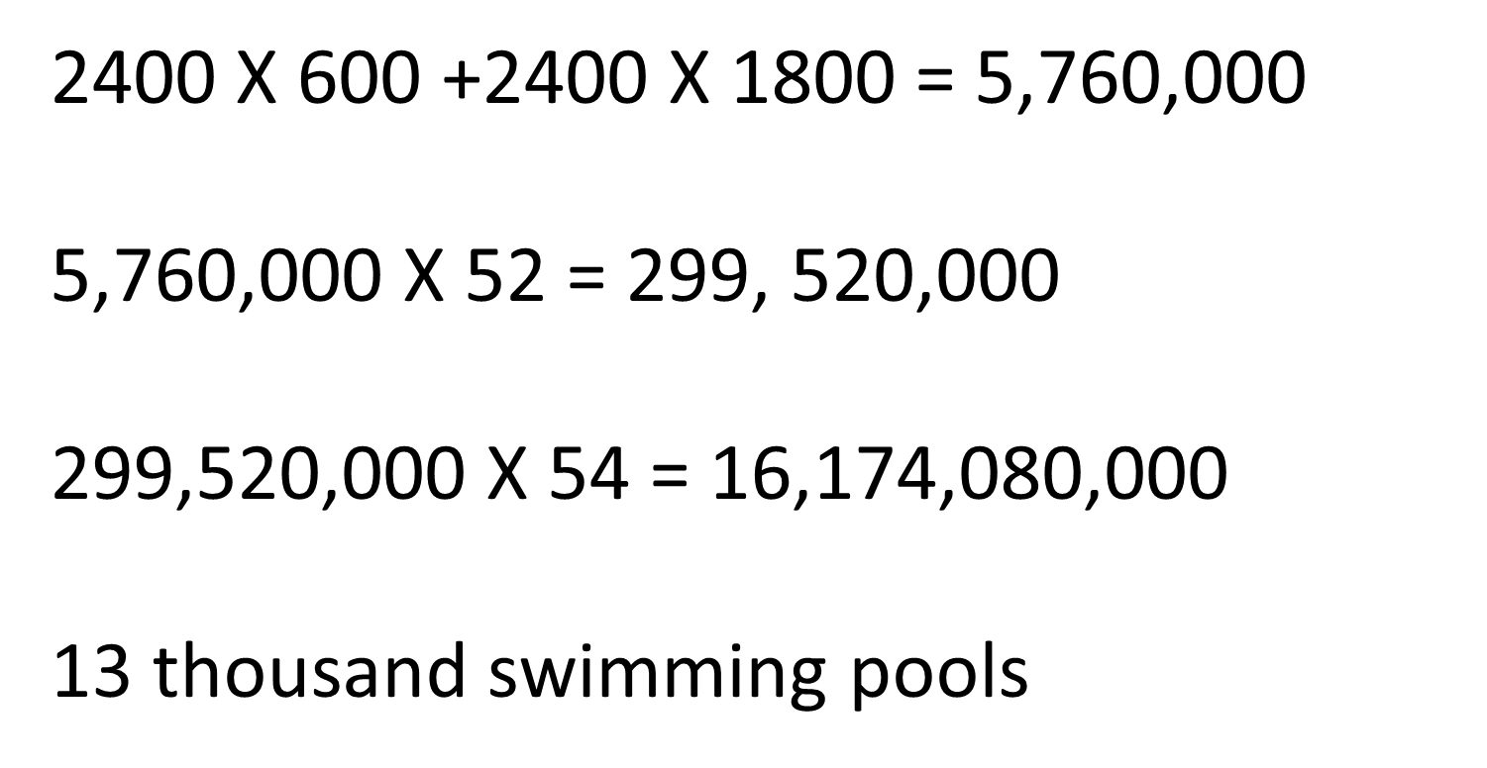
Our Schools, Our World Collectivism

Slide 73
The process
School Community
Working group
Research Findings
School sustainability strategies are most effective when schools are:
focused on well-being
Changemakers
Whole School
Training
Audit
and
Action
Council/MAT
Local experts and organisations
Nature Connection
Vision and Culture
Launch
Curriculum and Assemblies
Student + stakeholder voice

Slide 74
Our Schools, Our World Addressing Modern Disconnect

Slide 75
Our Schools, Our World 5 Ways to Wellbeing - MIND
CONNECT
BE ACTIVE
TAKE NOTICE
KEEP LEARNING
GIVE

Slide 76
The process
School Community
Working group
Research Findings
School sustainability strategies are most effective when schools are:
builds on social capital
Changemakers
Whole School
Training
Audit
and
Action
Council/MAT
Local experts and organisations
Nature Connection
Vision and Culture
Launch
Curriculum and Assemblies
Student + stakeholder voice

Slide 77
Our Schools, Our World 2 Year Rolling Programme
Curriculum
Concepts, Greening, Nature Connection
Theme 1
Assemblies
Actions
Theme 2
Assemblies
Actions
Theme 3
Assemblies
Actions
Theme 4
Assemblies
Actions
Theme 5
Assemblies
Actions
Theme 6
Assemblies
Actions
School Operations
Working towards Zero Carbon

Slide 78
Our Schools, Our World Overview
Leadership and organisational commitment
Setting/school policies founded on the UN Sustainable Development goals
Curriculum development relevant to context
Green skills and careers
School Action Framework
Links to other strategies e.g. anti-racism, disadvantage
Council and community engagement
Young people voice and agency
Training staff + induction and succession planning
Learning from and connecting with nature
Sustainable resourcing and estate management

Slide 79
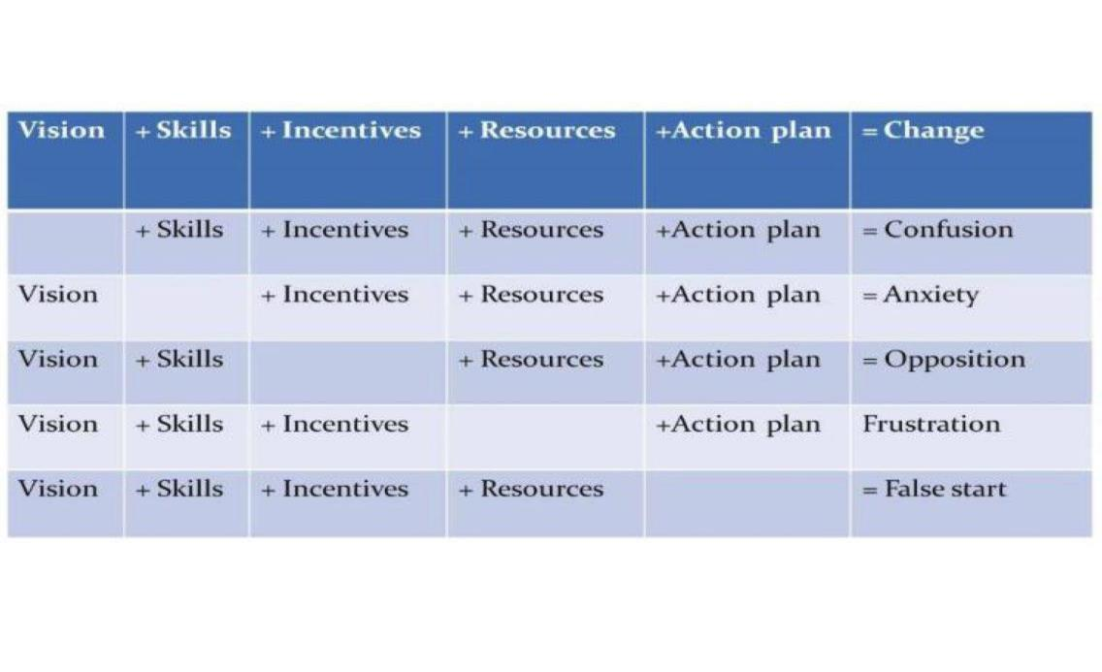
Our Schools, Our World Ensuring Effective Strategy

Slide 80
Our Schools, Our World Teach the Future – Guiding Principles

Slide 82
Our Schools, Our World Lunch 12:15 – 1:00
Group Photo!
Signing up to Let's Go Zero

Slide 83
LEADERSHIP FOR SUSTAINABILITY – Strategy and Framework

Slide 84
Environment (grounds etc) Curriculum Community Campus (emission reduction) Initiatives/projects Other
Our Schools, Our World
School Strengths

Slide 85
Our Schools, Our World 2 Year Rolling Programme
Curriculum
Concepts, Greening, Nature Connection
Theme 1
Assemblies
Actions
Theme 2
Assemblies
Actions
Theme 3
Assemblies
Actions
Theme 4
Assemblies
Actions
Theme 5
Assemblies
Actions
Theme 6
Assemblies
Actions
School Operations
Working towards Zero Carbon

Slide 86
Embedded video removed for size, find here: https://youtu.be/xwzAJVYlODo

Slide 87
1. Yellow 2. Grey 3. Orange 4. Green
Our Schools, Our World
The Framework

Slide 88
Our Schools, Our World The Framework – Stage One
Launch with governors
Standing item in staff meeting and governors meeting agenda
Survey school community
Set up sustainability working group
Launch programme with staff
Train staff in climate science and eco-anxiety
Create a sustainability vision
Integrate OSOW into school SIP

Slide 89
Our Schools, Our World The Framework – Stage Two
‘Green’ the curriculum
Develop assembly programme
Launch the OSOW programme
Complete carbon audits Plan ‘green events’ – Switch Off Fortnight’, Arts Week etc.
Engage PTFA, families, governors
Analyse procurement
Add OSOW to newsletter/website/noticeboards

Slide 90
Our Schools, Our World The Framework - Stage Three
Plan for organisation/community/ business engagement
Network with other schools
Plan for nature connection and outdoor learning
Create induction pack for new staff
Include sustainability in interviewing for new staff Include OSOW in school presentations for new parents
Establish a programme of assessment/evaluation

Slide 91
Our Schools, Our World The Framework – Stage Four
Completion of a Net Zero Route Map
Develop a nature recovery plan to increase biodiversity Include UN Sustainable Development Goals in lesson planning Provide opportunities for children to support campaigns locally or nationally Site manager and SBM establish sustainability meeting schedule

Slide 92
Our Schools, Our World
Connection with nature | Biodiversity areas development in school Downs and diversity – exploring on trip Plant a tree campaign https://www.woodlandtrust.org.uk/blog/2020/03/nature-detectives/ Swift project Wildlife walk with picnic – whole school David Attenborough film spectacular
Outdoor learning | More outdoor classroom - https://www.ltl.org.uk/free-resources/
Ethical purchasing/sustainable practice as a school | Palm oil/local produce/commit to vegan lunch days http://www.worldwiseschools.ie/downloads/Ethical-Purchasing-Guide.pdf
Political Engagement | Work with school lunch company – more vegan options https://www.wwf.org.uk/updates/8-things-know-about-palm-oil Campaign against palm oil - letter writing MPs
Connecting with local organisations | Class Talks and Assemblies Brighton and hove food partnership https://bhfood.org.uk/ Just one tree https://www.justonetree.life/ RSPB -https://ww2.rspb.org.uk/groups/brighton Local wildlife Campaigners Permaculture trust https://brightonpermaculture.org.uk/ Sussex Wildlife Trust https://sussexwildlifetrust.org.uk/ Brighton Greenway http://www.brightongreenway.uk/ Stringer Nature 2020 https://www.nature2020.org.uk/ Community Orchard Whitehawk https://bhfood.org.uk/directory/racehill-community-orchard/
Staff Behaviour | Environmental volunteering opportunities Outdoor relaxation area created
Emotional Resilience/Learning Behaviours/Relationships | Mindfulness within nature activities

Slide 93
OSOW in Secondary Schools
Strategy
Group
Council
MAT Academy chain
Student
Climate
Leaders
(2 from yr8-10)
School
Programme
Lead
Local Organisations
Climate Ambassadors
(5+ in each tutor group)
National Organisations
Whole School
(climate ambassadors and form tutors within tutor groups)

Slide 95
Our Schools, Our World Pledges
Brighton & Hove Primary & SEND School Pledges
By December 2026 we pledge to:
Waste: Remove single use plastics from our classes, staffroom and catering operations
Food: Promote a lower emissions menu, a greater plant-based offering and a
significant reduction in food waste
Energy: Reduce carbon emissions from energy by 20%
Water: Reduce water use by 20%
Biodiversity: Increase the amount of land given over to supporting biodiversity by 10%
Transport: Reduce staff car travel to school by 20%
Leadership: Track carbon emissions using the 'Count Your Carbon' tool
What would be possible in Leicester?
Climate Action Plans

Slide 96
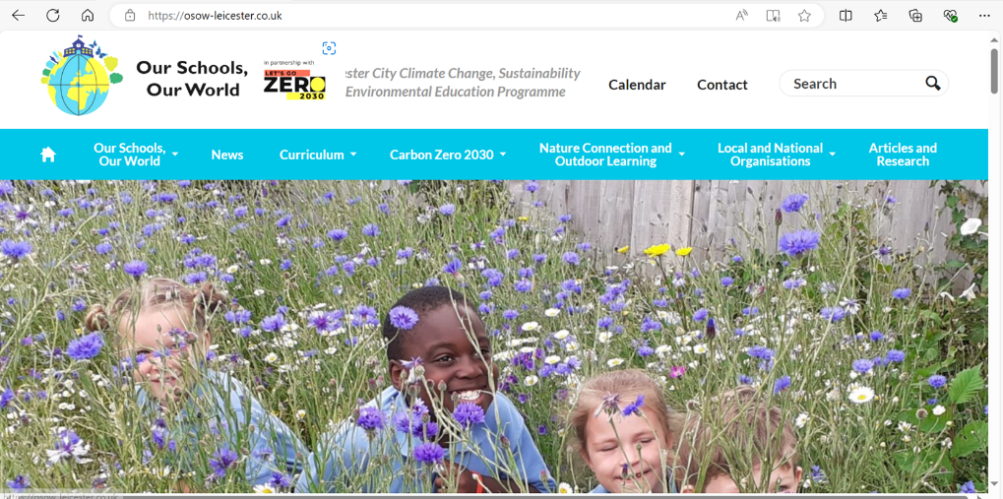
Our Schools Our World www.osow-leicester.co.uk
Climate999
Notes:
Claire

Slide 97
Our Schools, Our World First Support Visit
Contact:
marc.tench@leicester.gov.uk
From January we aim to meet with each school to help you on your OSOW journey and to support you implementing your plan ready for launch in the Summer term
Time: 3 hrs
Attending: SPL, SLT link/Governor link

Slide 98
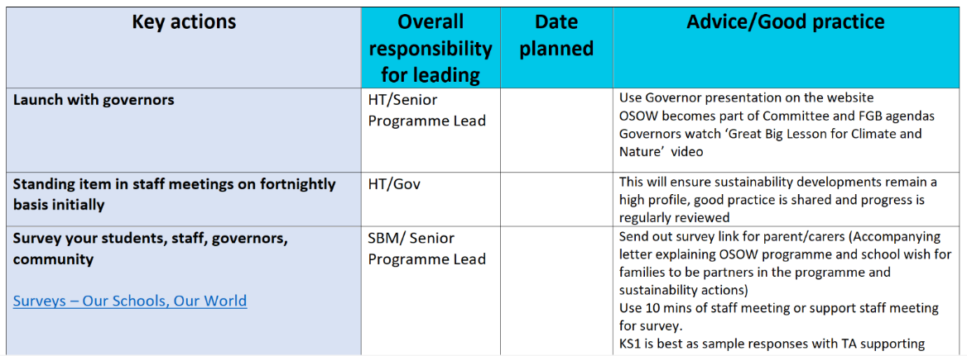
Our Schools, Our World Action Planning
“Process with guidance & advice” Document available here OSOW Framework – Our Schools, Our World

Slide 99
Our Schools, Our World Tomorrow
SPLs to arrive 9.00 for 9:15 start
Please bring laptop and example of medium-term curriculum plans
Please also bring school ID’s
Thursday – please confirm if site managers and business managers are attending and arrange a time to discuss content with them afterwards

Slide 100
Embedded video removed for size, find here: https://youtu.be/ysa5OBhXz-Q

Slide 101
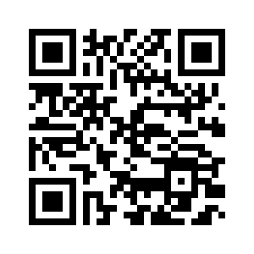
Our Schools, Our World Evaluation
Thank you

Slide 102
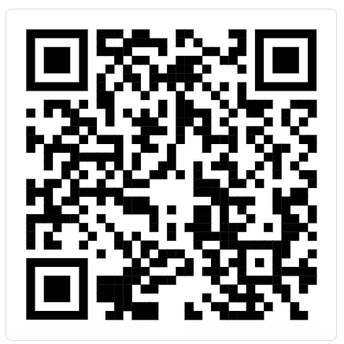
Sign up your school to Let’s Go Zero

