Slide 1
Our Schools, Our World
‘Your actions matter. No action or voice is too small to make a difference’
Vanessa Nakate
Brighton & Hove City Council
Katie Eberstein and Jonathan Cooper
Leicester City Council
Marc Tench, Laura Barke, Jasmine Walker

Slide 2
Our Schools, Our World Training Overview
Day One
Leading for Sustainability
City Hall
Attending: Heads, governor, SPL
----------------------------------------------------
9.15am – 3.30pm
Climate/Nature Basics
BREAK
Leading for Sustainability – Research
LUNCH
The OSOW Framework
Action Planning
Day Two
Curriculum Development
Queensmead Primary Academy
Attending: SPL
----------------------------------------------------
9.15am – 3.30pm
Curriculum Development
BREAK
Curriculum Assessment
LUNCH
Nature Connection & Outdoor Learning
How to Talk About Climate Change
(ThoughtBox)
Day Three
Climate Action Planning
City Hall
Attending: SBM, Site Manager, SPL
-----------------------------------------------------
9.15am – 3.30pm
Climate/Nature Basics
BREAK
Climate Action Planning - background
LUNCH
Measuring Carbon
Climate Action Planning - practical

Slide 3
Our Schools, Our World Housekeeping
Fire exits
Toilets
Photographs
Tea/Coffee/biscuits provided

Slide 4
Our Schools, Our World Agenda
Time | Session
9:00 | Attendees to arrive
9:20 | Introductions and Overview
9:40 | Climate Basics
10:25 | Break
10:45 | Climate Action Plans – the Background
12:15 | Lunch
13:00 | Count Your Carbon
13:30 | Climate Action Planning
15:00 | Next Steps
15:15 | Finish

Slide 5
Montrose School
Achieving, Caring, Aspiring
Our Schools, Our World - Leicester schools
Queensmead
Primary Academy
Scraptoft Valley Primary School

Slide 6
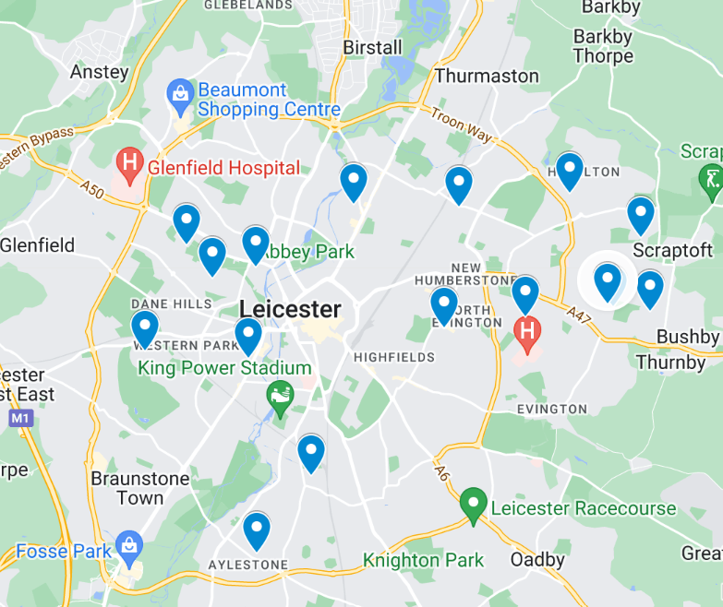
16
6700
800

Slide 7
Our Schools, Our World
Introductions
On your tables:
Name, Role, School
Why are you here today?

Slide 8
Our Schools, Our World Who’s Involved
Devon Brent Bedfordshire Leicester Brighton & Hove

Slide 9
Our Schools, Our World
Aims of OSOW
Develop an integrated environmental education curriculum gradually and systematically ‘greening’ the curriculum and supporting the development of green skills
Enable children and young people to develop a close connection with nature
Create school organisational systems and practices which support sustainability and the school and regional Carbon Neutral 2030 targets
Empower children and young people and their families to become changemakers both personally and collectively and inspire a strong sense of hope for the future

Slide 10
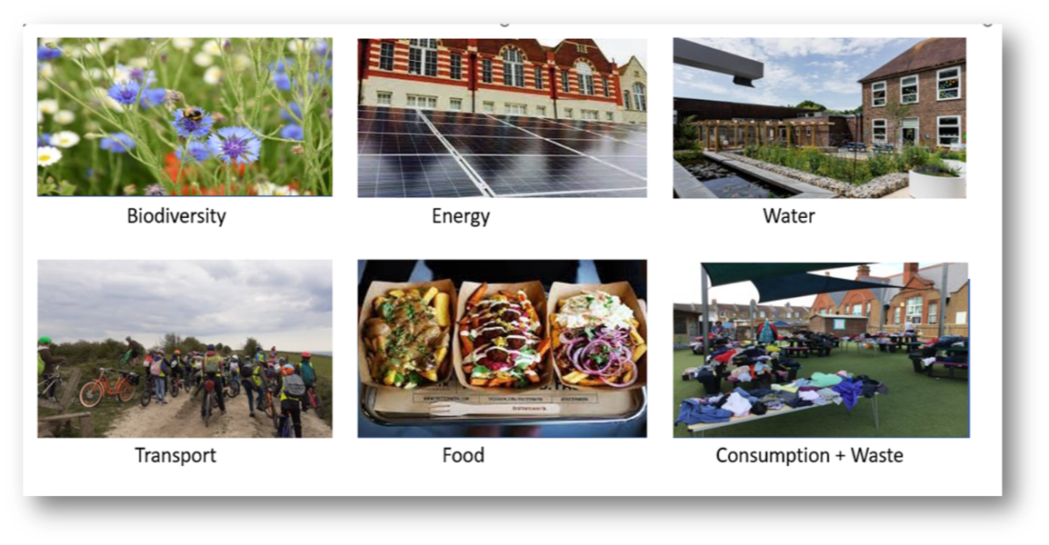
Our Schools, Our World
6 Themes

Slide 11
Our Schools, Our World
2 Year Rolling Programme
Curriculum
Concepts, Greening, Nature Connection
Theme 1
Assemblies
Actions
Theme 2
Assemblies
Actions
Theme 3
Assemblies
Actions
Theme 4
Assemblies
Actions
Theme 5
Assemblies
Actions
Theme 6
Assemblies
Actions
School Operations
Working towards Zero Carbon

Slide 12
The process
School Community
Training
Nature Connection
School
Surveys
Assemblies + Action
Local Authority
Local experts and organisations
Strategy Group
Net Zero Audits
Launch
Curriculum Review
Student and stakeholder voice

Slide 13
Our Schools, Our World
Planning for Effective Action
Set ‘smart’ targets – balance of impact and ease
Roles and responsibilities
Education and understanding
Campaigning
Audit / establish baselines
Cultural, behavioural and operational change evaluated
SMART
Specific
Measurable
Achievable
Relevant
Timetabled
Action

Slide 14
Our Schools, Our World
Strategy Group
Headteacher | Lead the vision and strategy Facilitate the delivery of OSOW
Governor | Ensure OSOW is on FGB and committee agendas Monitoring and evaluation
Senior Programme Lead | Lead and monitor the implementation of the framework alongside headteacher Coordinate training and establish links between the school, local organisations and Climate Action Advisors

Slide 15
Our Schools, Our World
Strategy Group
School Business Manager | Lead on the decarbonisation and procurement element of the Climate Action Plan and support work on biodiversity, adaptation and resilience Support the implementation of the framework through practical actions e.g. sending out surveys
School Site Manager | Provide practical support and advice to the School Business Manager around school operations, identify opportunities to reduce emissions and increase biodiversity in school buildings and grounds
Others e.g. parents, local community, local organisations, young people | Link schools, families and local communities Bring in expertise to enrich the strategy

Slide 16
Embedded video removed for size, find here: https://youtu.be/1WchgajHiUc

Slide 17
Our Schools, Our World
Climate Change Basics
CAUSE
CONSEQUENCE
Human Activity
Greenhouse Gases
Greenhouse Effect
Climate Consequences
Impact on the Planet
Impact on Humans
Impact on Biodiversity
SOLUTIONS ?

Slide 18
CAUSE
CONSEQUENCE
Human Activity
Greenhouse Gases
Greenhouse Effect
Climate Consequences
Impact on the Planet
Impact on Humans
Impact on Biodiversity
SOLUTIONS ?

Slide 19
Our Schools, Our World
What does this mean for your school?

Slide 20
https://youtu.be/rWuKYuEOI9k
Embedded video removed for size, link below

Slide 21
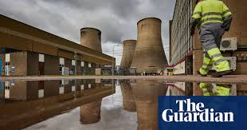
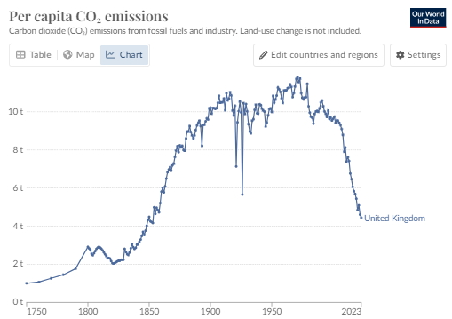
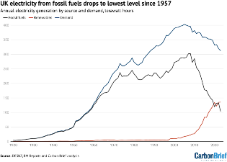
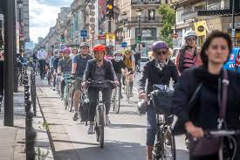
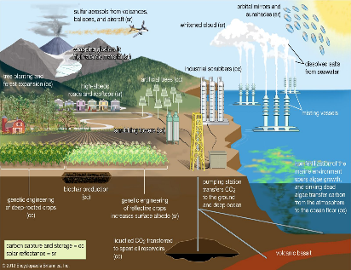
Reasons for optimism
Our Schools Our World Reasons for Optimism – nationally & globally

Slide 22
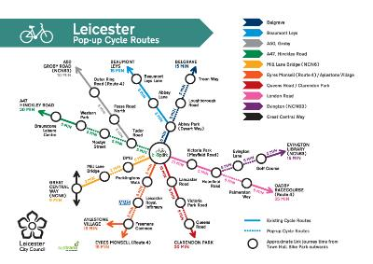
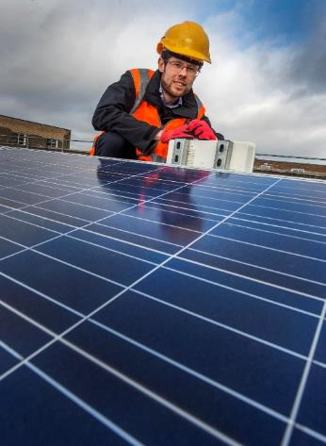
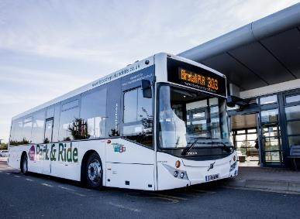
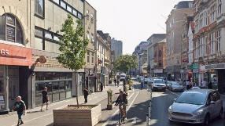
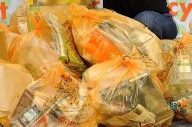
Reasons for optimism
Our Schools Our World Reasons for Optimism - locally
Well-connected cycle routes across the city and beyond
Electrification of bus network
634 kWp PV systems on council buildings generating 524,954 kWh/y
A total of 63.72 % of waste was diverted from landfill (2022-23)
Further pedestrianisation across the city

Slide 23
Reasons for optimism
Our Schools Our World Reasons for Optimism – our Schools
Sharing good news from your schools

Slide 24
Our Schools, Our World
A New Vision
What if…
Energy
Consumption and Waste
Transport
What if…
Food
Water
Biodiversity

Slide 25
"There is an antidote to doom and despair. It's action on the ground, and it's happening in all corners of the earth.” Christiana Figueres, UN Executive Secretary on Climate Change (6 Nov 2024)
Our Schools, Our World

Slide 26
Our Schools, Our World
DfE Sustainability & Climate Change
By 2025:​
All education settings will have nominated a sustainability lead
​
All education settings will have put in place a climate action plan
decarbonisation
adaptation and resilience
biodiversity
climate education and green careers

Slide 27
Our Schools, Our World
The Climate Emergency in Leicester
Leicester City Council’s
Climate Ready Leicester Plan
A plan for warm homes, lower bills, solar energy, new skills and jobs, clean air and a greener, resilient city

Slide 28
Climate Ready Leicester aims
1. A net zero city
2. Reduced emissions outside the city
3. An adapted and resilient city
4. A people-centred transition
5. A net zero and climate-adapted council
Leicester City Council declared a Climate Emergency in 2019

Slide 29
The action plan
96 actions across seven themes
Refreshed annually
Includes
Net Zero Delivery Plan for our own estate and operations
Further housing retrofit and low carbon new-build
Low carbon workspaces at Dock 3-5, Pilot House, Pioneer Park
Green skills bootcamps
Continued work across active travel, buses and EV infrastructure
Further flood schemes and engagement with communities at risk
Aligning new Waste Strategy with climate aims
Climate Ready Leicester comms campaign including action guide for residents and more

Slide 30
Our Schools, Our World
Decarbonisation
Carbon emissions in Leicester?????
Looking at this data another way, the major priorities are…
HOMES
39%
BUILDINGS
35%
ELECTRICITY
HEAT
CARS/VANS
… and everything else

Slide 31
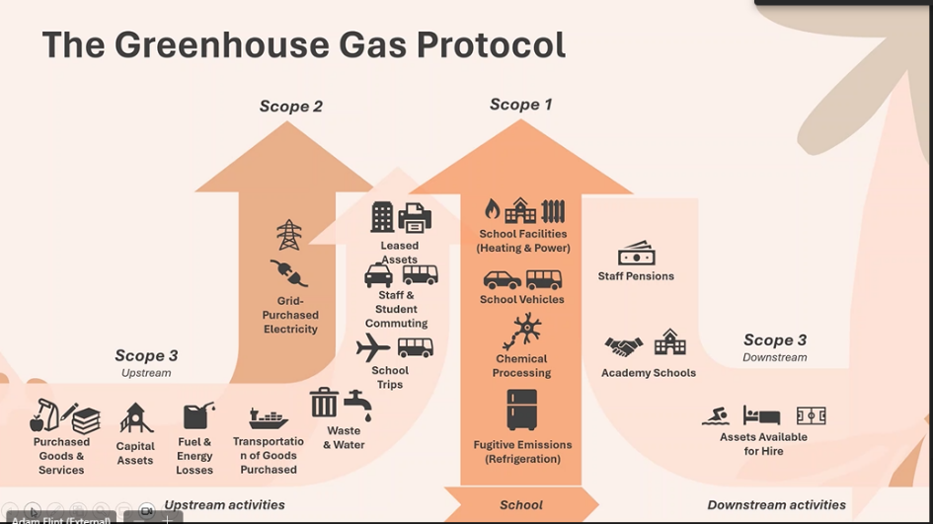
Our Schools Our World Scope 1,2,3 emissions

Slide 32
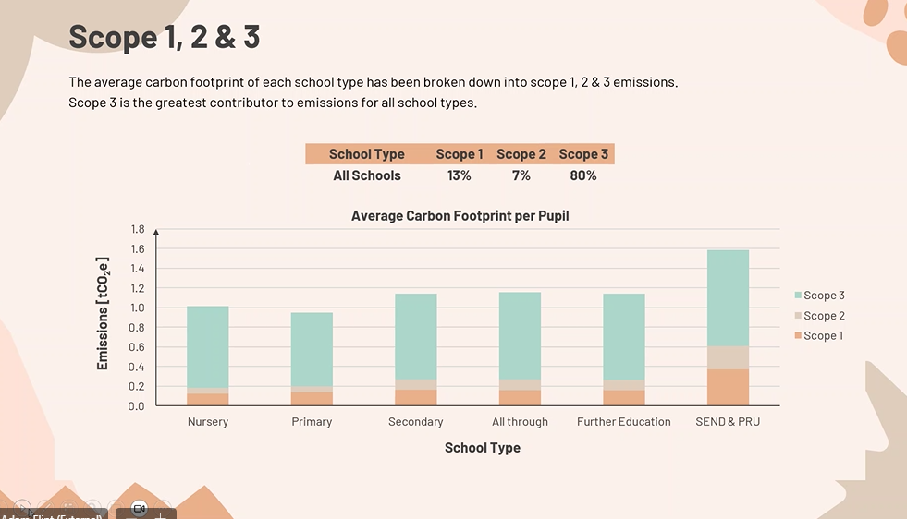
Our Schools Our World Scope 1,2 & 3 emissions

Slide 33
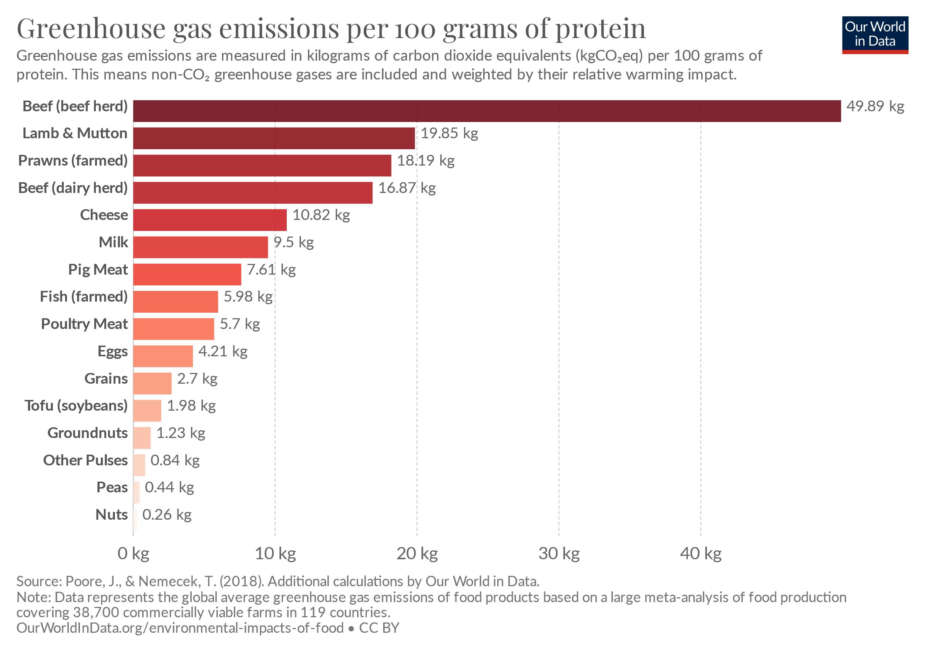
Our Schools Our World Decarbonisation - school food
60%+
of food GHG
10%+ of all human induced GHG

Slide 34
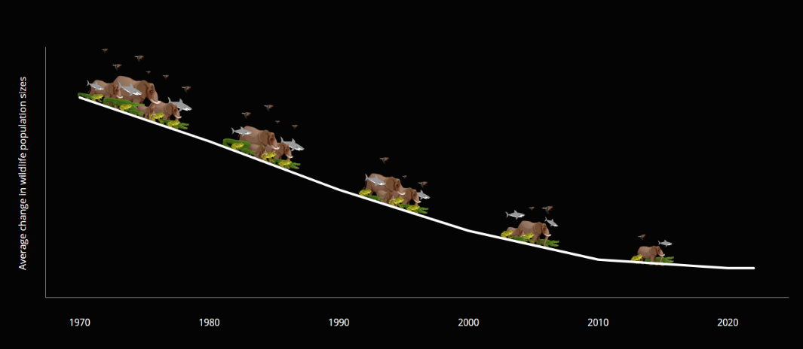
Our Schools Our World Biodiversity Loss – Living Planet Report 2024

Slide 35
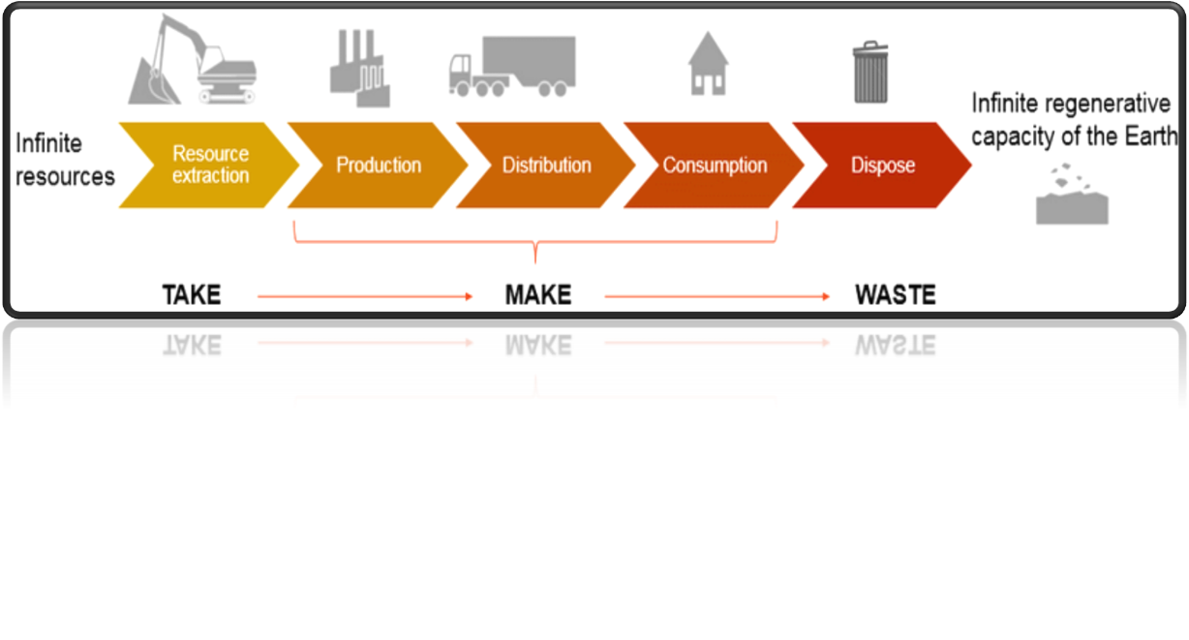
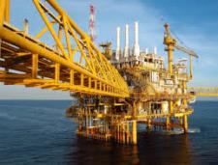
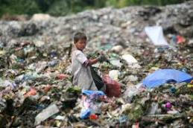
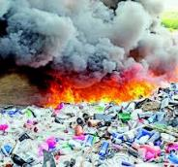
Our Schools Our World Resources

Slide 36
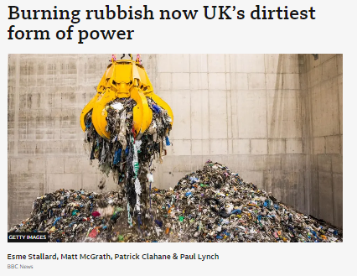
Our Schools Our World

Slide 37
Our Schools Our World Procurement & Ecological Footprint

Slide 38
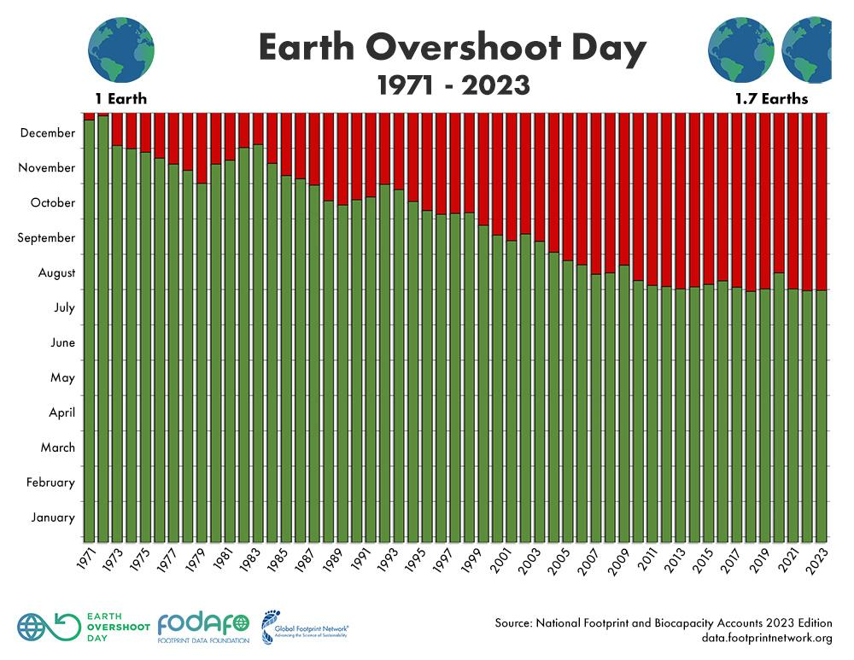
Our Schools Our World Earth Overshoot Day

Slide 39
Our Schools Our World A global perspective

Slide 40
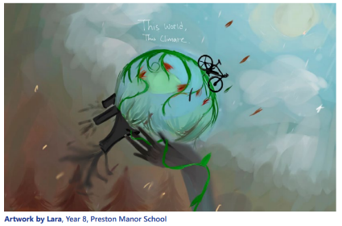
Our Schools Our World Climate Basics – Climate Justice
Our Schools Our World Climate Justice
What does Climate Justice mean?
Climate justice is about acknowledging and addressing how disadvantaged or vulnerable communities around the world experience greater effects of climate change, even though they have contributed fewer emissions.

Slide 41
Our Schools Our World Circular Economy

Slide 42
Our Schools, Our World Change Our Approach
1.REFUSE
2.REDUCE
3.REUSE
4.REPAIR
5.REPURPOSE
6.RECYCLE
7.RECOVER

Slide 43
Our Schools, Our World
Procurement
A good procurement decision
Initial cost
Greener product e.g. fair trade, energy efficient, recycled
Delivery
Running costs
Management
Disposal
42% of school carbon emissions come from procurement

Slide 44
Our Schools, Our World
Procurement
Is your purchase necessary? What alternative solutions may be available?
Sharing equipment or services with another school
Taking from a local business
Working in a different ways
Reducing
Reducing waste
Reusing
Repairing
Repurposing
Amnesty
Extended warranties
Consider an audit e.g. a print audit
Could you gain from economies of scale by delaying short-term purchases where possible/sharing purchases with another school? Bundling together purchases from the same supplier can cut down delivery costs – less mileage means less fuel consumed to supply you.

Slide 45
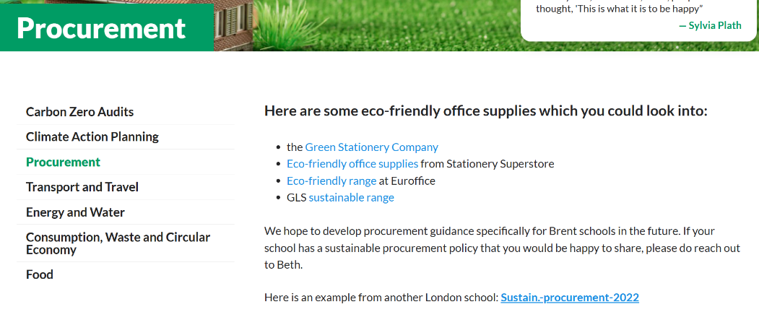
Our Schools, Our World
Procurement
https://osow-brent.co.uk/carbon-neutral-2030/procurement/

Slide 46
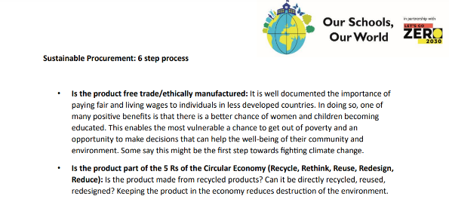
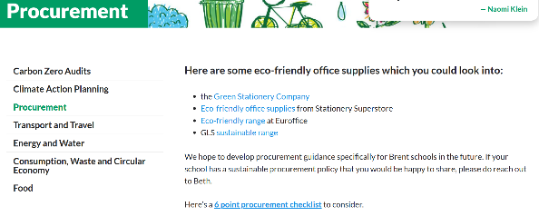
Our Schools, Our World
Procurement Checklist
Finally …….a simple 6-point checklist
Is the product free trade/ethically manufactured:
Is the product part of the 5 Rs of the Circular Economy (Recycle, Rethink, Reuse, Redesign, Reduce):
Timeless over Trendy:
Is the product environmentally labelled?
Is the product manufactured within a country with controlled environmental standards?
Is the product natural/biodegradable?

Slide 47
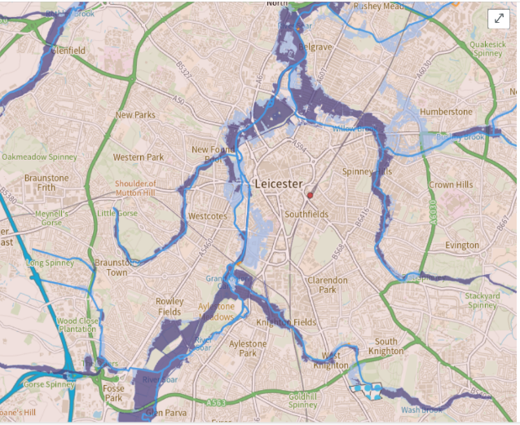
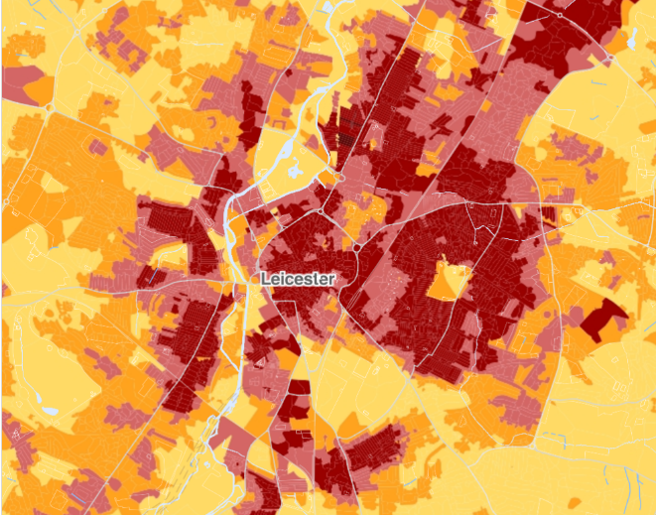
Our Schools Our World Adaptation & Resilience
Flood Risk
Vulnerability to extreme heat
Notes:
Explore the Climate of your Local Authority

Slide 48
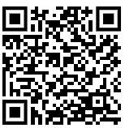
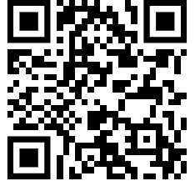
Our Schools, Our World
Adaptation and Resilience
Scan for UK Government flood risk map
Scan for UK Government heat risk map

Slide 49
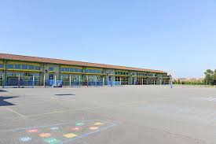
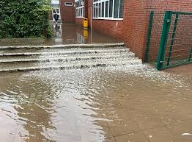
Our Schools Our World Adaptation & Resilience
Are our schools prepared for hotter summers and wetter winters?

Slide 50
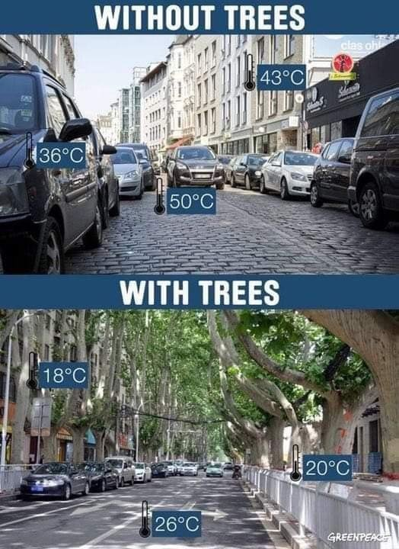
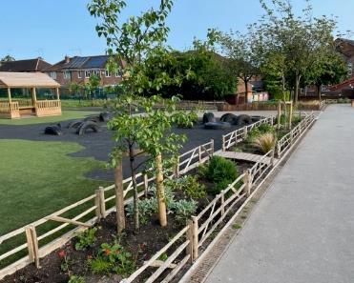
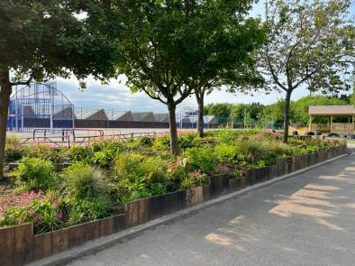
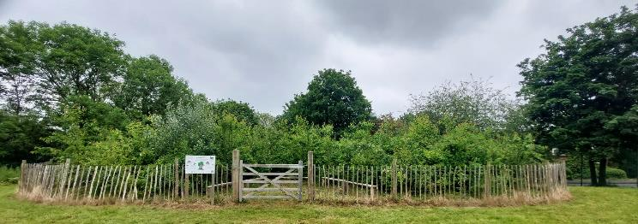
Our Schools Our World Adaptation & Resilience Nature Based Solutions

Slide 51
Embedded slide removed for size, find here: https://youtu.be/a4lvkZIKs14

Slide 52
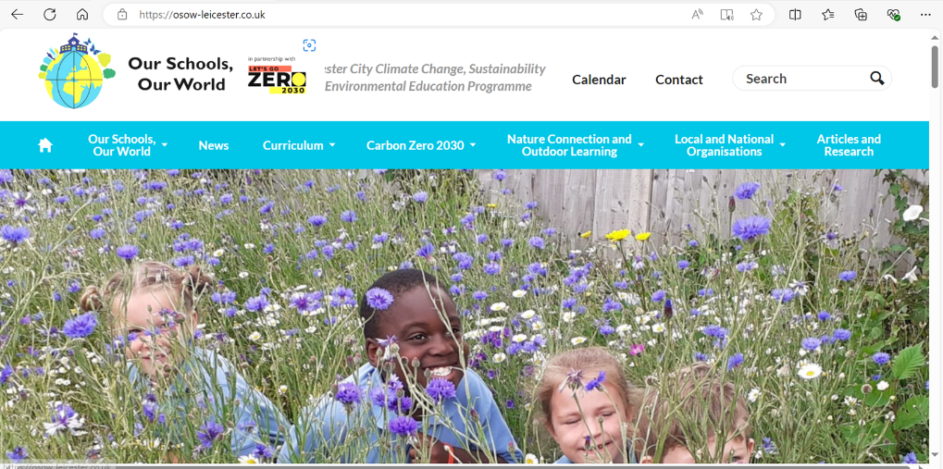
Our Schools Our World Climate Education & Green Careers
www.osow-leicester.co.uk Climate999

Slide 53
Our Schools Our World Decarbonisation – opportunity for pledges
Waste: Remove single use plastics from our classes, staffroom and catering operations
Food: Promote a lower emissions menu, a greater plant-based offering and a significant reduction in food waste
Energy: Reduce carbon emissions from energy by 20%
Water: Reduce water use by 20%
Biodiversity: Increase the amount of land given over to supporting biodiversity by 10%
Transport: Reduce staff car travel to school by 20% (one day less a week)
Leadership: Track carbon emissions using the Count Your Carbon tool

Slide 54
Introducing
Let’s Go Zero

Slide 55
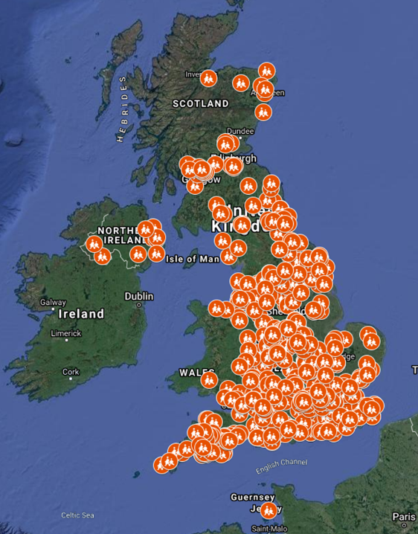
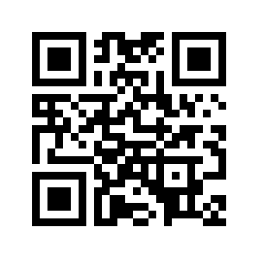
Let’s Go Zero
The national campaign for all schools, colleges and nurseries to be zero carbon by 2030.
Over 4,200 schools, colleges and nurseries signed up to the campaign.
Representing more than 1 in 10 schools and over 1.7 million students.
By joining our campaign, your school confirms that it is taking action and asks the government to do the same.
Join the campaign now…
www.letsgozero.org/join

Slide 56
Working collaboratively
Let’s Go Zero coalition
Our partners
Notes:
If using the ‘Let’s Go Zero’ slide above, delete the top sentence on this slide.
56

Slide 57
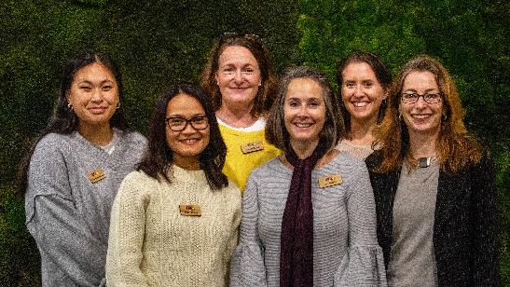
Climate Action Advisors
A network of free, independent experts working to accelerate schools, colleges and nurseries on their journey to become zero carbon – further, faster.
Support schools to understand their carbon impact, make effective plans, and find funding and resources.
“Supporting you to meet the DfE Expectation that all schools have a Climate Action Plan and Sustainability Lead in place by 2025”

Slide 58
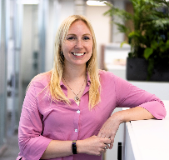
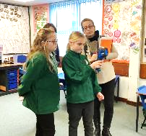
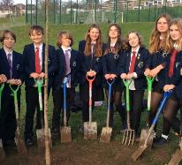
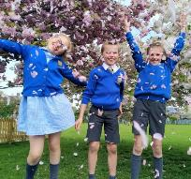
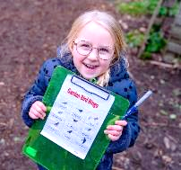
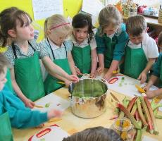
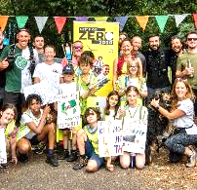
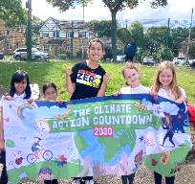
Climate Action Advisor support
1:1 Advice, Support and Signposting
Remote or In-Person Audit
Sustainability Report with Suggested Actions
Carbon Footprint Calculation
DfE aligned Climate Action Plan
Funding, Grants and Competitions
Curriculum-Linked Resources
Networking, Case Studies, Guides and Templates
Accreditation Schemes
Local and National Initiatives

Slide 59
How we work with schools
Initial meeting with designated Climate Action Advisor (CAA)
Sustainable Leadership established within school
School contacts Let’s Go Zero to request support.
Recommended actions, templates, guides, advice about potential funding and local and national support schemes.
Site visit or virtual audit
CAA gathers information about school
School decides what to include in their Climate Action Plan
CAA provides Sustainability Report and supporting resources.
School’s carbon emission baseline calculated by CAA.
Repeat steps 4-10 each year
School celebrates and communicates actions and achievements
School takes action and measures progress against targets
CAA checks in regularly to provide additional support.
Share successes and engage with others
Notes:
Briefly describe the journey for how Climate Action Advisors support schools.
Key message is our provision of bespoke support to schools, meeting them where they're at in their sustainability journey and supporting them to not only meet DfE's expectations but also achieve their emission reduction targets and overall sustainability goals.

Slide 60
Notes:
If using the ‘Let’s Go Zero’ slide above, delete the top sentence on this slide.
60

Slide 61
Energy Sparks
Energy Sparks works with schools to offer a unique, effective energy management tool, which monitors energy use and provides bespoke, simple low / no-cost recommendations, provided weekly.
Costs £545 a year - but the average primary school saves £3,000 per year
Learning opportunities through interactive pupil dashboard and education programme, which includes a range of over 140 activities and resources including lesson plans.
Tailored induction webinars for range of school staff. Guidance on over 60 low and no-cost actions.
Set targets and track progress. Score points and compete with other schools.
Additional optional services such as energy audits and assemblies also available at additional cost.
Energy Sparks are a trusted member of the Let’s Go Zero coalition.
Example: Find schools near you and explore their data and advice.

Slide 62
Embedded video removed for size, find here: https://youtu.be/x2EeYWwdEpE

Slide 63
Modeshift STARS
A national awards scheme that recognises schools, businesses and other organisations that have shown excellence in supporting cycling, walking and other forms of sustainable and active travel.
Provides comprehensive toolkit that assists in developing, implementing and monitoring/evaluation Travel Plans.
Free for schools to participate! Schools automatically have a brand new national standard School Travel Plan upon completion of application.
Electric Vehicle Chargepoints
Workplace Charging Scheme for state-funded education institutions enables schools to apply for grants to cover 75% of the cost to buy and install chargepoints.
Funding is confirmed until 31 March 2025. Eligibility criteria applies. See guidance for more information.
Installers can enable different tariff rates for staff and members of the public.

Slide 64
New Recycling Regulations
From 31 March 2025, all schools must collect and recycle food waste and key recyclable materials.
Support for getting your school ready
Food Waste Recycling
Food waste can no longer be placed in general waste bins or mixed with other recyclable materials and must be put into a specific food waste container for collection.
Mixed Recycling
They must ensure they are recycling the following materials:
Paper (envelopes, magazines, copier paper, shredded paper)
Cardboard (cardboard boxes, corrugated cardboard)
Plastic (bottles, tubs, trays, containers)
Metal (aluminium and steel tins, cans, foil)
Glass (bottles, jars)

Slide 65
Water
Severn Trent offer free water efficiency audits for every business, including schools in Nottinghamshire, Derbyshire, Leicestershire and Staffordshire as part of their Green Recovery programme. Includes supply and installation of water saving improvements.
To arrange a free water audit:
Email supporting-businesses@severntrent.co.uk or complete the online form (for Business, enter 'school' and for employees enter 'pupils and staff')
Workshops and visits
Free in-school workshops including The Wonderful Water Tour, primary school visits to their sites, interactive buses that can visit your school - all suitable for primary age.
Secondary Education
Book a 30-min in-school Science of Sewage session, which covers the role of Severn Trent, the science behind their work, information on bioresources, pollution and careers. Also available virtually.

Slide 66
National Education Nature Park
An exciting project that connects children and young people to nature and empowers them to play a part in improving biodiversity and reducing climate change.
High quality resources and support to embed climate and nature across the curriculum
Support developing new or improved green spaces in education settings
Guide to finding local help and funding

Slide 67
Example Additional Support
Decarbonisation and Sustainability Support:
Midlands Net Zero Hub
Retrofit Action for Tomorrow (RAFT)
Climate Ambassadors
Sustainability Support for Education
Biodiversity and Adaptation and Resilience:
Learning through Landscapes
Tree Council
Wildlife Trust
RHS School Gardening Scheme
And many more!

Slide 68
Our Schools Our World Local Support for Schools
Sustrans’ Schools Cycling Officers are based in LCC Walking and Cycling team. Activities include:
Cycle skills
Dr Bikes and maintenance workshops
Bike breakfasts
Bike rides
Assemblies
Classroom sessions; and
National competitions and events such as Bike to School Week, and The Big Walk and Wheel
Leicester Sustrans support for schools
Living Streets – UKs walking charity who work with schools in Leicester to reduce congestion and improve air quality and road safety around the school gate.
Includes WOW travel tracker
Leicester Living Streets support for schools
LCC waste management team offers a range of activities tailored to your school for all things recycling and waste related. Including, assemblies, workshops and classroom presentation recycling support for Leicester schools
Green Fox Community Energy - Leicester and Leicestershire’s community energy non profit organisation. Aims to facilitate the increase of community owned renewable and low carbon technology
greenfoxcommunityenergy.org

Slide 69
Our Schools Our World Climate Action Plans
Adam Flint – Keep Britain Tidy

Slide 70
Our Schools Our World Climate Actions
Cost - circle
Impact
Ease
Can you share any other actions?

Slide 71
Our Schools, Our World
2 Year Rolling Programme
Curriculum
Concepts, Greening, Nature Connection
Theme 1
Assemblies
Actions
Theme 2
Assemblies
Actions
Theme 3
Assemblies
Actions
Theme 4
Assemblies
Actions
Theme 5
Assemblies
Actions
Theme 6
Assemblies
Actions
School Operations
Working towards Zero Carbon

Slide 72
Let’s Go Zero
Creating Your Climate Action Plan

Slide 73
DfE Policy Paper - 2022
Sustainability and climate change: a strategy
for the education and children’s services systems
“With the campaign Let’s Go Zero, we will set targets for schools between 2025 and 2035.” “By 2025: All education settings will have a designated sustainability lead and a climate action plan.”
“A climate action plan should typically cover the following four areas:
Decarbonisation - calculating and taking actions to reduce carbon emissions
Adaptation and Resilience - taking actions to reduce the risk of flooding and overheating
Biodiversity - e.g. engaging with the National Education Nature Park
Climate Education and Green Careers - ensuring education provided gives comprehensive teaching about climate change, and teaching staff feel supported to offer this”

Slide 74
Decarbonisation

Slide 75
What causes carbon emissions in schools?
Which do you think is the biggest cause of carbon emissions in schools according to the Count Your Carbon team?
Energy?
Food?
Transport?
Purchases?
Waste?
www.letsgozero.org
charity no: 1104153

Slide 76
What causes carbon emissions in schools?
The carbon emissions from waste are quite low- it is our over consumption that needs addressing.
The energy a school uses is from their heaters (often gas powered) plus electricity use for lights and tech. Most schools are not yet using renewable energy.
School Uniform is included in the “purchases” a school community can take responsibility for. It can be a large part of this total.
The transport total includes how the pupils travel to and from school. It also includes how the teachers and staff travel to and from school. Petrol/diesel cars create high carbon emissions.
The emissions from food are calculated by how many meat meals are served. Meat tends to have a higher carbon footprint than plant-based food.

Slide 77
Calculate your school’s carbon footprint

Slide 78
Decarbonisation - Example Actions
PILLAR | EXAMPLE ACTIONS
Energy | Monitor energy use and take regular actions (Energy Sparks, BESS Energy) | Switch to 100% LED lighting and install motion sensors in corridors and toilets | Ensure your BMS/BEMS has efficient timings and temperatures set for the school day e.g. 6am-1pm at 18 degrees in classrooms. | Train staff on heating efficiency practices eg turn heating down vs opening windows | Install solar panels (Solar for Schools)

Slide 79
10 mins​
Break Out: Energy
Split into groups of 3-4 people
What Energy actions will you put in your Climate Action Plan and why?
Who will lead on this?
When will you schedule action?
Pledge your actions (with your school name) in the post-its

Slide 80
Decarbonisation - Example Actions
PILLAR | EXAMPLE ACTIONS
Transport | Carry out travel surveys and create an Active Travel Plan (Modeshift STARS) | Run an 'Active Travel’ week each term (Sustrans, Living Streets) | Install sufficient amount of bike and scooter racks | Encourage lift-sharing | Install electric vehicle charge-points

Slide 81
Break Out: Transport
10 mins​
What Transport actions will you put in your Climate Action Plan and why?
Who will lead on this?
When will you schedule action?
Pledge your actions (with your school name) in the post-its

Slide 82
Decarbonisation - Example Actions
PILLAR | EXAMPLE ACTIONS
Food | Have 1-2 plant-based days a week | Review menu to make it more sustainable (Pro-Veg) | Food waste recycling in all areas where food is produced and consumed. | Measure and reduce food waste from canteen | Start a school veg patch & gardening club

Slide 83
Break Out: Food 10 mins
What Food actions will you put in your Climate Action Plan and why?
Who will lead on this?
When will you schedule action?
Pledge your actions (with your school name) in the post-its

Slide 84
Decarbonisation - Example Actions
PILLAR | EXAMPLE ACTIONS
Procurement | Reduce branding on uniform and school items | Implement a ‘Sustainable Procurement Policy’ Refuse Reduce Reuse | Use a School Resources Exchange site | Consider carbon footprint and environmental practices of the services/ companies you use | Replace ICT equipment / appliances that is at end of life with energy-efficient alternatives
Waste | Hold regular uniform or clothes swaps. Aim to quantify the amount of items recycled | Recycling bins in all classrooms and offices with clear signage. | Take part in waste-reducing initiatives and ban single-use plastic (Plastic Clever Schools) | Establish community recycling collections e.g. textiles, batteries, ink cartridges (many generate funds / vouchers) | Consider sustainable practices when disposing of E-waste e.g. Air Ambulance

Slide 85
Build these questions into the whole lifecycle of your procurement process
Do we really need the thing we're buying, or can we extend the life of the product we already have?
What are we buying and is it a sustainable product? Is it socially responsible / does it have human rights issue e.g. modern slavery?
Be very clear about what you're buying or contracting and what the impact is on these issues.
Who are we buying from? Do we understand our supplier base? Is the supplier ethical, sustainable? Do they have the right level of practice for us to be using or working with? How do we validate this in pre-qualifying them? Do they have the right accreditations? Is there oversight on their sustainability and social responsibility?
When it comes to end of life, how are we managing the waste and packaging?
Ask suppliers what they can support you with e.g. takeback schemes on packaging
What is currently more visible and hidden within the procurement process
Source: UK SSN Sustainability Procurement

Slide 86
Break Out: Procurement and Waste 10 mins
What waste and procurement actions will you put in your Climate Action Plan?
Who will lead on this?
How will you operate differently to form new habits?
How will you communicate this to your community?
Pledge your actions (with your school name) in the post-its

Slide 87
Planning for Action 10 mins
Whole Group:
Share key findings from each group – any similarities?
How could you network and support each other?
Everyone:
What #1 action will you be taking to your school?
LET’S GO!

Slide 88
Adaptation and resilience
Biodiversity
Climate Education

Slide 89
Climate Action Plan - Example Actions
DfE Area | Pillar | Example Actions
Adaptation and Resilience | Adaptation and Resilience | Adopt the National Education Union’s 'Heatwave Protocol' | Conduct a climate resilience audit (Learning through Landscapes)
 | Water | Install water-saving systems e.g. push taps and cistern bricks (Severn Trent) | Encourage water-saving behaviours with signs and posters
Biodiversity | Nature | Enrol with National Education Nature Park | Engage with local and national initiatives (Tiny Forests, WWF)
Climate Education and Green Careers | Culture | Establish Sustainability Leadership Group | Join schemes that encourage and reward eco-action (Eco-Schools)
 | Curriculum and Green Skills | Carry out a curriculum audit to incorporate sustainability (Our Schools, Our World) | Request a Climate Ambassador to deliver a Green Skills workshop

Slide 90
Climate Action Plan
Please contact me if you would like further advice and support with developing your sustainability work and Climate Action Plan. Jelly.Moring@letsgozero.org

Slide 91
Our Schools Our World Climate Action Plans

Slide 92
Our Schools Our World Climate Action Plans

Slide 93
Our Schools Our World Climate Action Plans

Slide 94
Our Schools Our World Climate Action Plans

Slide 95
Our Schools Our World Climate Action Plans

Slide 96
Our Schools Our World Operations
UKSSN Operations Group

Slide 97
1. Meet with SPLs and Headteachers to complete the OSOW framework 2. Meet with Marc in Jan/Feb to review CAP
Our Schools, Our World
Next Steps

Slide 98
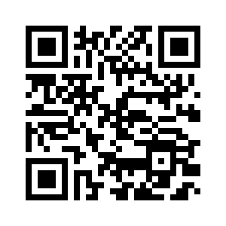
Our Schools Our World Evaluation
Thank you
We look forward to working with you again soon!

Slide 99
Our Schools Our World Operations
Embedded video removed for size, find here: https://youtu.be/ysa5OBhXz-Q

